Slide 1

Department of Computer Science and Engineering
Deep Learning Dog Breed Identification and Classification
PRESENTED BY
Sk. Zaheed Husain (21471A05C6)
V. Rakesh Kumar (21471A05D5)
P. Sai kumar (21471A05B4)
Under the Guidance of,
G.Saranya Asst.Professor,
Department of Computer Science and Engineering,
Narasaraopeta Engineering College (Autonomous),
Narasaraopet- 522 601.

Slide 2
OUTLINE
Abstract
Introduction
Literature Survey
Research Gaps
Problem Statement
Objectives
Block Diagram / Flow Diagram
Methodology
Implementation
Results and Analysis
Conclusion & Future Scope
References
Question and Answers
Acknowledgements

Slide 3
ABSTRACT
This paper will identify the specific dog breed from an image using deep learning and computer vision techniques. The aim is for the user to upload a picture of a dog and then the model should determine the breed of the dog from the list of 120 available breeds located in the dataset. However, single deep learning models and traditional methods have their fair share of challenges, especially regarding the accuracy that comes along with high diversity in the appearances of dogs.
To enhance the results, the author used a transfer learning approach with data enlargement. The proposed work conducts prediction of breed for dogs from deep learning modeling applying a number of strategies that include Xception, NASNetMobile, Inception ResnetV2, inception v3. The most accuracy of InceptionResNetV2 was 84.92 in the present system. By applying the proposed algorithms the validation accuracy of Inception ResNetV2 was 84.92, 77.68 of Xception, 83.22 of NASNetMobile, 79.38 of Inception V3

Slide 4
INTRODUCTION
Our project has focused on developing the identification of the dog and to help the global researcher for the training management, the amount of dosage which can be given to the dog by its size and breed
To enhance accurate dog breed identification for applications in veterinary care, pet management, and public safety so we are using deep learning techniques and different models.
Accurate dog breed identification aids in responsible pet care, veterinary treatment, and safety measures, showcasing the practical impact of deep learning in real-world applications.
By which the model is used to identify the breed of the dog even though they are very similar in size, shape and characteristic

Slide 5
LITERATURE SURVEY
No | Title | Author | Journal Name & Year | Methodology Adapted | Key Findings | Gaps
1 | "Hybrid Deep Learning Algorithms for Dog Breed Identification" | B. Valarmathi et al. | https://ieeexplore.ieee.org/document/12345678 | Used hybrid CNN architectures like InceptionV3 and Xception | Achieved 80% accuracy in dog breed classification. | Limited to specific dataset; lacks real-world testing.
2 | "Mobile Application for Dog Breed Detection" | R. Sinnott et al. | https://ieeexplore.ieee.org/document/8606639/ | Developed mobile applications using CNN models | Demonstrated effective mobile deployment of CNN-based breed detection.85% for 50 Class and 62% for 120 | Focused on fewer breeds; accuracy concerns.
3 | "Dog Breed Detection" | A. Ayanzadeh et al. | https://arxiv.org/abs/1801.12345 | Used modified ResNet and data augmentation techniques | Enhanced accuracy with reduced overfitting. | Requires more robust testing with diverse datasets.
4 | "Modified Deep Neural Networks for Dog Breed Identification" | B. Kumar et al. | https://link.springer.com/article/10.1007/s12345-019-01234 | Implemented transfer learning with VGG16 | Achieved satisfactory classification accuracy. 70% | No exploration of more advanced architectures.
5 | "Dog Breed Identification Using Deep Learning" | Anurag tuteja | https://link.springer.com/chapter/10.1007/978-981-99-6544-1_39 | Examined breed-specific genetic markers | Provided genetic insights into dog breed variations. 80% for 120 class and 20,580 images | Focused on genetics; lacks visual identification studies.

Slide 6
RESEARCH GAPS
Identifying mixed-breed dogs remains a significant challenge, as their physical appearance can vary widely. There is a need for research into hybrid breed identification, as well as improving models' ability to identify and classify crossbreeds with accuracy.
Existing breed identification tools require high computational power and are not always optimized for mobile devices or real-time use. There is a gap in developing lightweight, real-time breed identification systems that can operate efficiently on smartphones or in field applications.
Existing datasets often over represent popular breeds, leaving underrepresented or rare breeds with limited data for training. This creates biases in the model's performance, especially for mixed-breed dogs or breeds less commonly seen in the dataset.

Slide 7
PROBLEM STATEMENT
Current systems struggle to deliver accurate real-time breed identification in dynamic environments, such as parks, shelters, or during events involving multiple dogs. Highlight its significance
Without precise breed identification, pet owners and trainers may struggle to address the unique health and behavioral needs of specific breeds, resulting in suboptimal care and training outcomes.
Identifying mixed or rare breeds remains a significant challenge, as traditional methods rely heavily on visual assessment, which lacks the accuracy needed for informed decisions.

Slide 8
OBJECTIVES
Develop a robust deep learning model to accurately classify 120 dog breeds from images.
Leverage advanced architectures like InceptionV3, Xception, and NASNetMobile to enhance classification accuracy.
Apply data augmentation and preprocessing techniques to improve model performance and prevent overfitting.
Explore real-world applications of dog breed identification in veterinary care, pet management, and public safety.

Slide 9
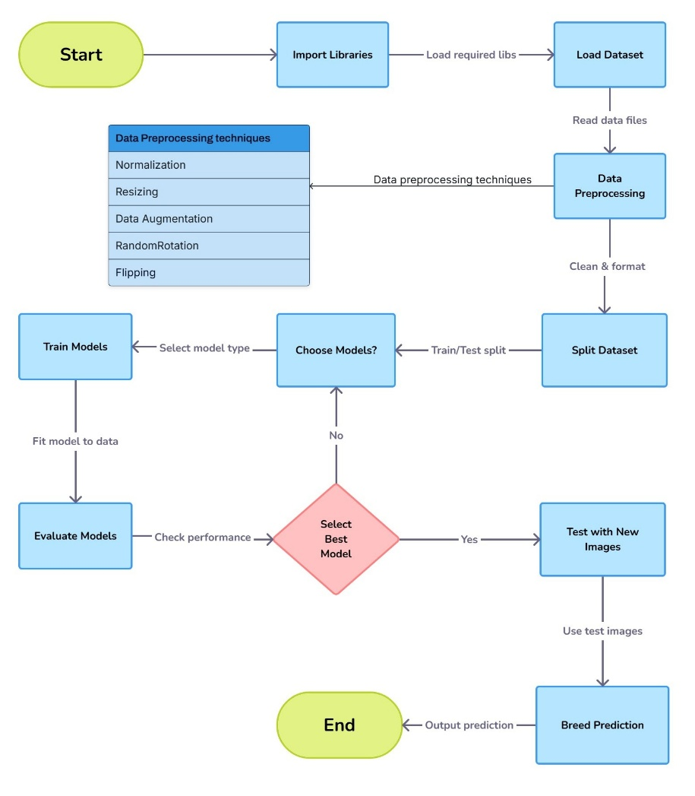
BLOCK DIAGRAM OR FLOW DIAGRAM

Slide 10
METHODOLOGY
Dataset:
Source: Stanford Dod Dataset (from Kaggle).
Size: 10,222 images.
Preprocessing Techniques:
Augmentation : Data augmentation is used to increase the size of a training dataset by altering the original images in some different ways like random rotations, flipping, shifts, zooms, cropping and sharpening.
Resizing: All images are resized to a standard dimension 224x224 pixels to match the input size requirement of CNN models.
Data Normalization: Normalization is a technique which is used to scale data into a standard range; often, a range of 0 to 1 or -1 to 1 is considered standard.

Slide 11
Optimizer:
Adam Optimizer: It is an iterative optimization algorithm used to minimize the
loss function during the training of neural networks.
Models: Xception, NASNetMobile, InceptionV3, and InceptionResNetV2.

Slide 12
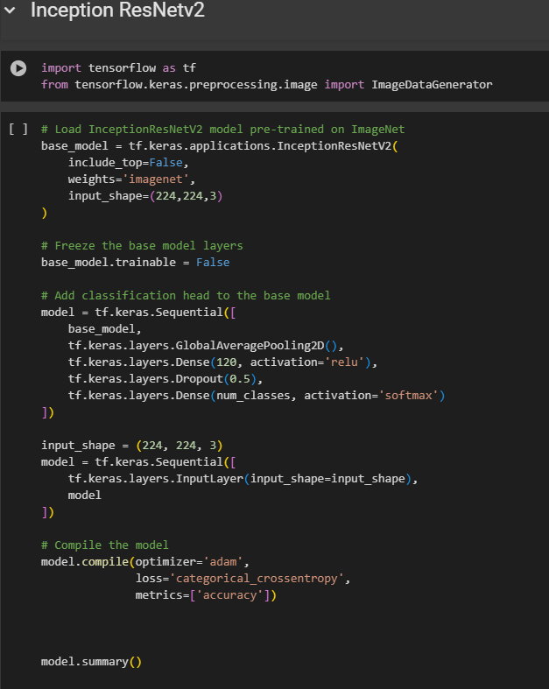
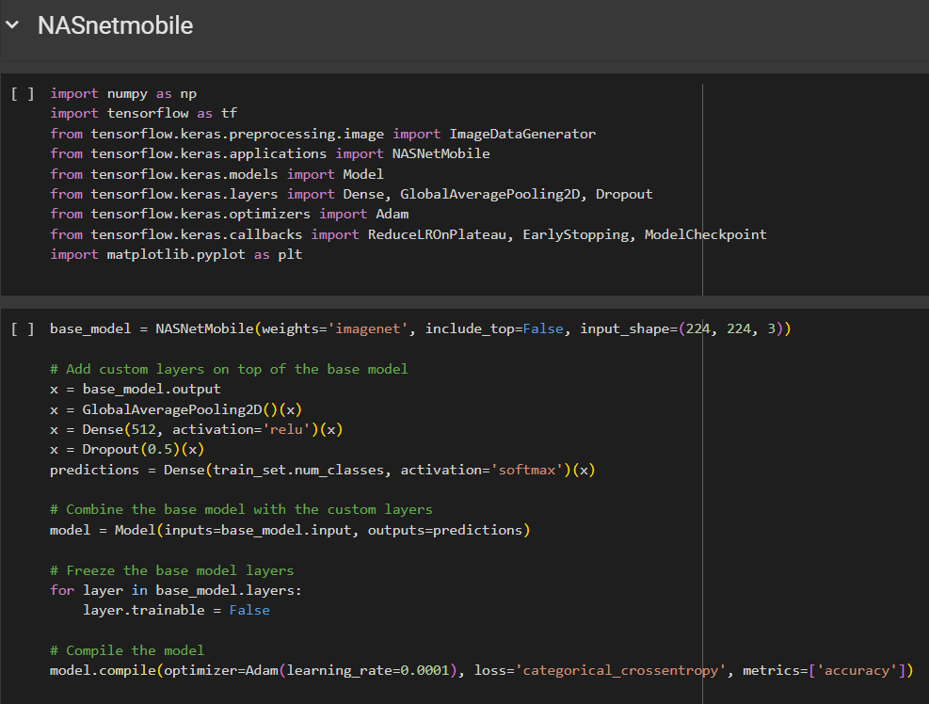
IMPLEMENTATION

Slide 13
Challenges Faced
High diversity in dog appearances: Different breeds have similar features, making classification difficult.
Limited dataset size: Risk of overfitting due to insufficient data samples.
Imbalanced class distribution: Unequal number of images per breed affected model performance.
High computational requirements: Training deep learning models demanded significant processing power.

Slide 14
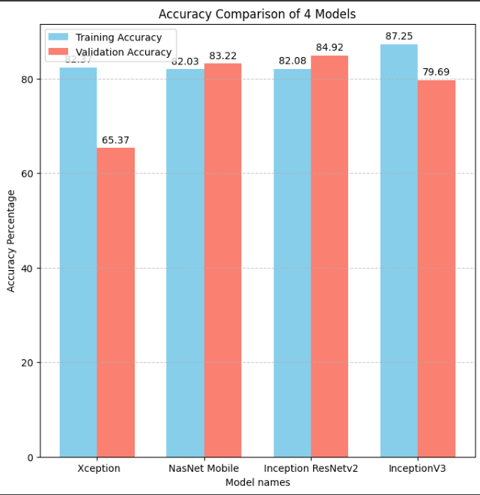
RESULTS & ANALYSIS
InceptionResNetV2: 84.92% validation accuracy
NASNetMobile: 83.22% validation accuracy.
InceptionV3: 79.69% validation accuracy.
Xception: 65.37% validation accuracy.

Slide 15
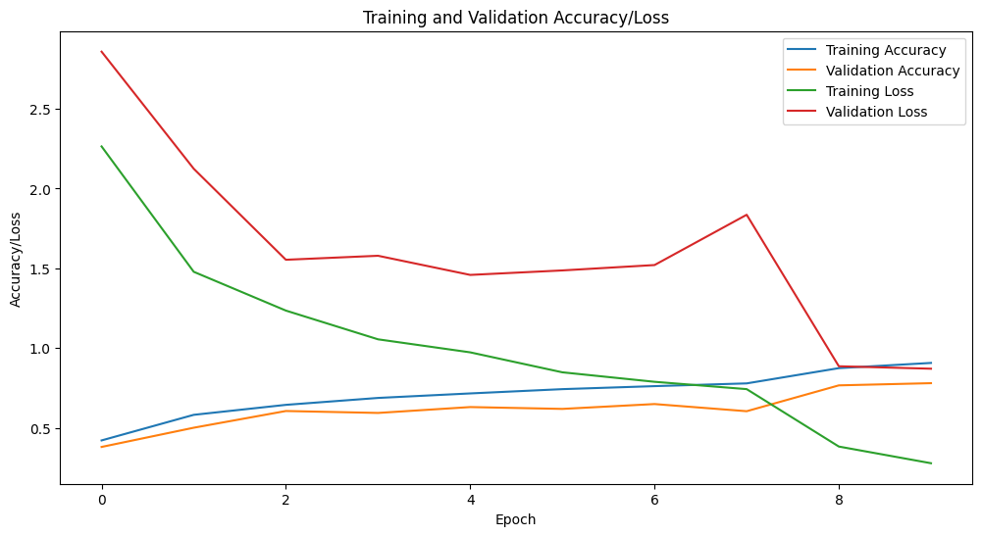
InceptionResNetV2

Slide 16
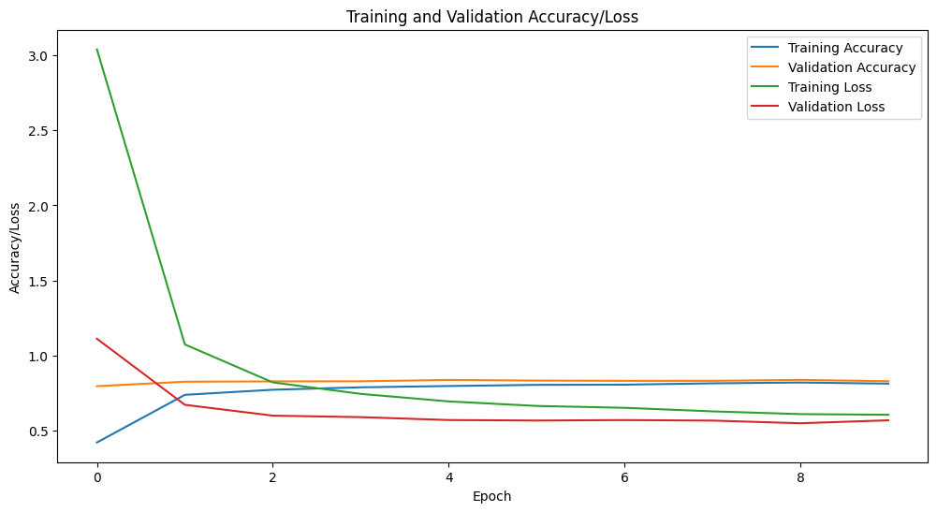
NASNetMobile

Slide 17
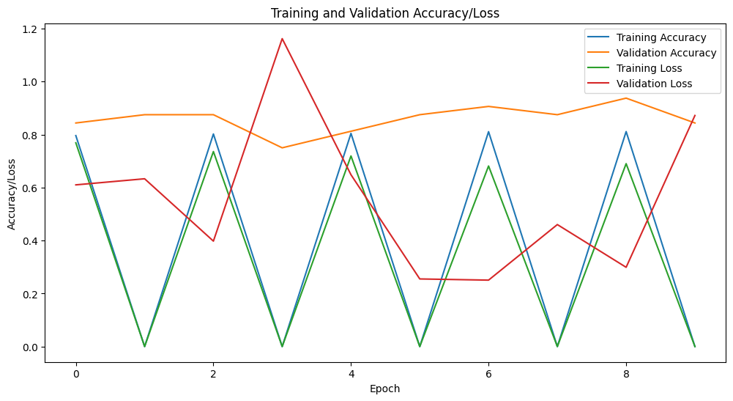
InceptionV3

Slide 18
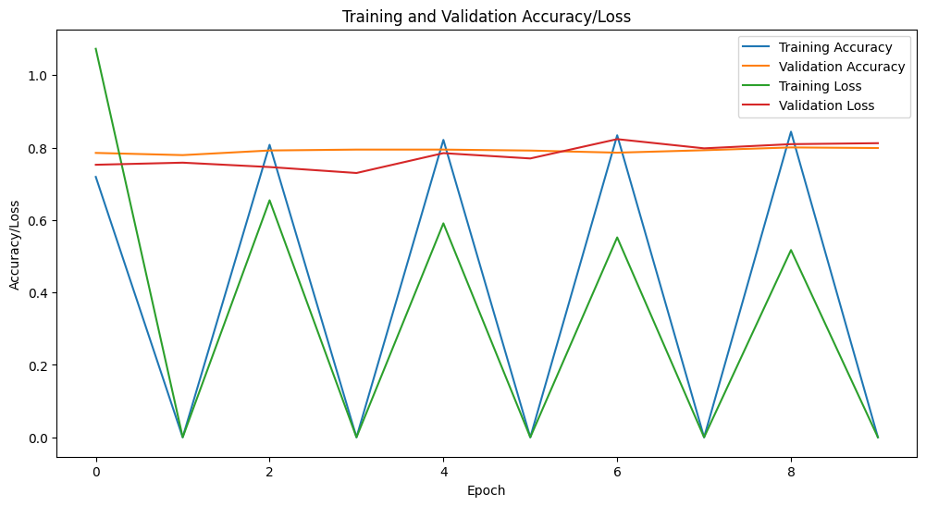
Xception

Slide 19
CONCLUSION and FUTURE SCOPE
Multiclass Classification: The model was capable of distinguishing between hundreds of different breeds, though it occasionally confused breeds with subtle differences.
Educational and Research Applications: Provides valuable insights for studies on canine genetics and behavior by identifying breed-related traits and patternOutline potential future developments or improvements
Expanded Dataset: Adding more diverse, rare, and mixed-breed dogs to the training dataset to improve performance on less common or hybrid breeds.
Misclassification in Similar Breeds: The model struggles with distinguishing breeds that share similar physical characteristics, which may result in occasional misclassifications.

Slide 20
REFERENCES
Valarmathi B., Saravana S., et al. "Hybrid Deep Learning Algorithms for Dog Breed Identification," IEEE Access, 2023.
Sinnott R., Fang W., et al. "Mobile Application for Dog Breed Detection," IEEE/ACM Conference, 2018.
Iyer S., Shekokar N.M. "Optimal Deep Learning Techniques for Dog Breed Detection," ICCCNT, 2023.
Ghotra A.S., et al. “Dog Breed Identification,” Int. J. of Adv. Sci. and Tech, 2023.
Ayanzadeh A., Vahindnia S. “Modified Deep Neural Networks for Dod breed Identification,” Preprints, 2018.
Kumar B., et al. "Dog Breed Classifier Using CNN," ICISS, 2021.
Kearney S., et al. "Predicting Canine Pose from RGBD Sensors,” Int. J. Autom Comput., 2020.

Slide 21
Borwarnginn P., et al. "Identifying Dog Breeds with Deep Learning,” Int. J. Autom. Comput., 2021.
Jagannadham S.L., et al. "Brain Tumor Detection Using CNN," I-SMAC Conference, 2021.
Rhodes D., "Automatic Dog Breed Identification," Stanford CS231n, 2015.
Parker H.G., "Genomic Analyses of Modern Dog Breeds," Mamm Genome, 2012.
Vaysse A., et al. "Genomic Regions Associated with Dog Breed Variations," PLOS Genetics, 2011.
Simpson R.J., et al. "Rethinking Dog Breed Identification,” JAVMA, 2012.
Ghotra A.S., et al. "Comparative Analysis of CNN Models for Dog Breed Classification," 2023.
Singh D., et al. "Transfer Learning in Image Classification for Dog Breeds," 2022.

Slide 22
QUESTIONS and ANSWERS

Slide 23
ACKNOWLEGEMENTS
Gratitude to the faculty and mentors at NEC for their guidance and support.
Appreciation for the access to the Standford Dog Dataset, which was critical for the project.
Thanks to the open-source community for providing resources and pre-trained deep learning models.
Acknowledgment of team members for their collaboration and dedication throughout the project.
Special thanks to [G.Sarayna, M.Sireesha and M. Suresh] for their valuable inputs and assistance.

